Slide 1
National Parents Union Survey Of K–12
Public School Parents
October 2020
N=1,000 parents of K-12 public school students
October 19–27, 2020

Slide 2
Methodology
We are conducting monthly online surveys of parents of K-12 public school students throughout the 2020–2021 school year to better understand their experiences and challenges they may be facing, as well as their views on education and other issues affecting families.
Results are weighted by gender, age, race/ethnicity, education, and region to reflect known population demographics.
Field Dates and Sample Sizes:
September 21–29, 2020 (N=1,140)
October 19–27, 2020 (N=1,000)

Slide 3
Parents’ Experiences And Views
On Their Child’s School

Slide 4
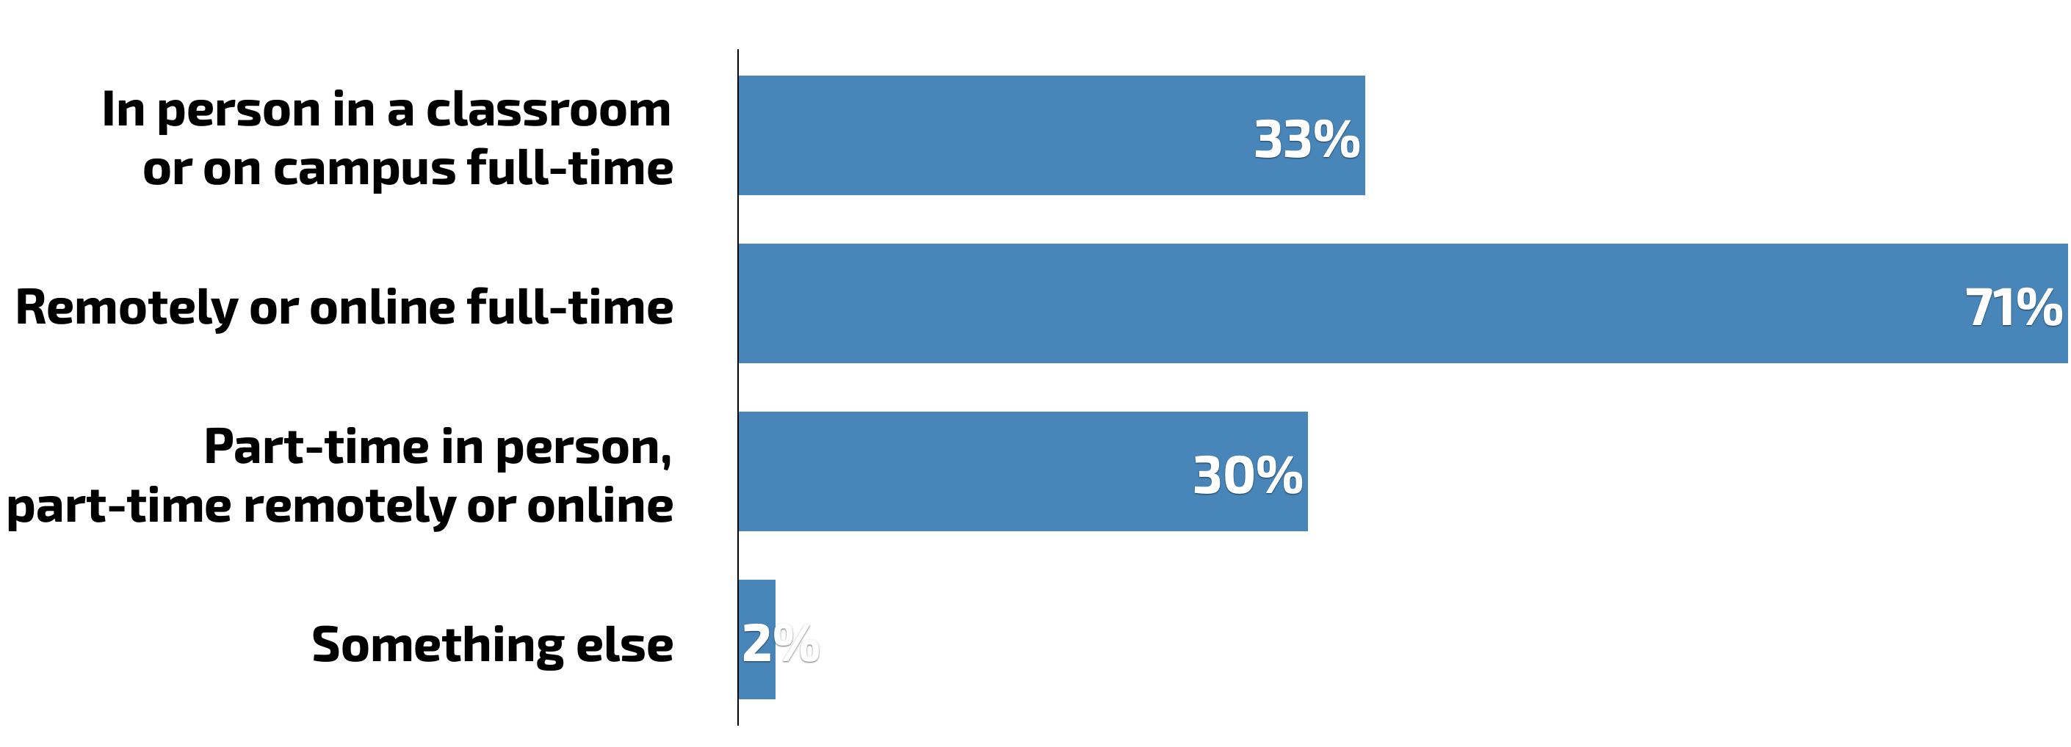
Most Offered Remote Learning Option
Q. What options is your child’s school currently offering for ways your child could attend school? Please select all options that your child’s school is offering, regardless of how your child is currently attending school.
October 2020
Sep. 2020
34%
70%
29%
3%

Slide 5
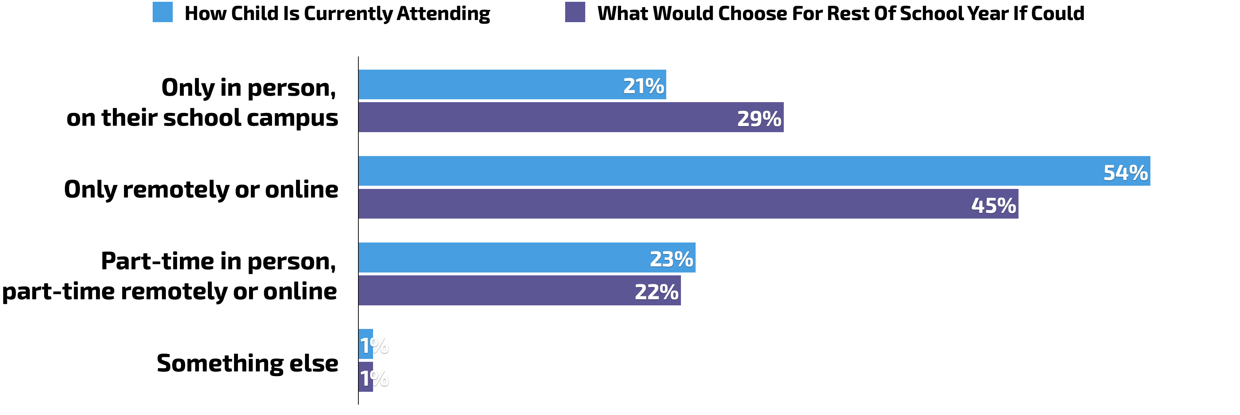
Over Half Have Child Currently Attending Only Remotely Or Online,
Somewhat Fewer Would Choose To Continue Remote Learning
Q. How is your child currently attending school?
Q. Now, if your child’s school were to allow you to choose ANY of these ways for your child to attend school for the rest of this school year, which would you choose?
Note: 3% said “Unsure” when asked what they would choose.

Slide 6
Most Parents Only Offered One Option; Only Slight Differences Between White Parents And Parents Of Color In Specific Options
Q. What options is your child’s school currently offering for ways your child could attend school? Please select all options that your child’s school is offering, regardless of how your child is currently attending school.
October 2020 | All Parents | White | Black | Hispanic | Asian/Other
In person in a classroom or on campus full-time | 33% | 35% | 32% | 32% | 23%
Remotely or online full-time | 71% | 69% | 76% | 72% | 72%
Part-time in person, part-time remotely or online | 30% | 29% | 26% | 34% | 35%
Something else | 2% | 3% | *% | *% | *%
ONLY ONE OPTION OFFERED | 72% | 72% | 71% | 73% | 75%
MULTIPLE OPTIONS OFFERED | 28% | 28% | 29% | 27% | 25%

Slide 7
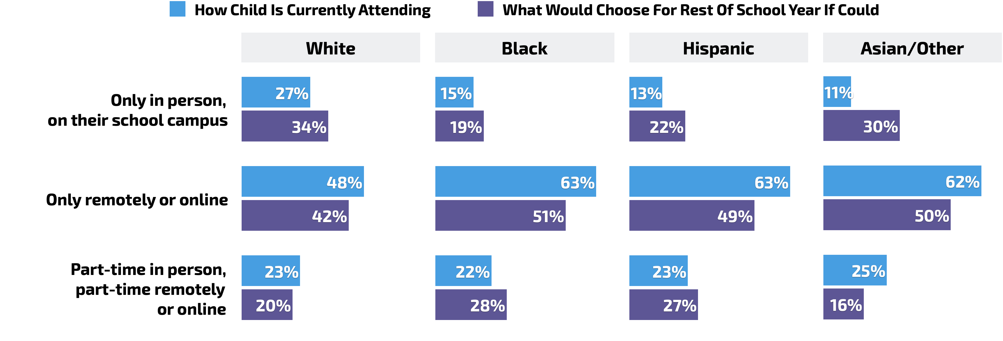
Parents Of Color More Likely To Choose Remote Learning
Q. How is your child currently attending school?
Q. Now, if your child’s school were to allow you to choose ANY of these ways for your child to attend school for the rest of this school year, which would you choose?
Note: “Something else” and “Unsure” about what they would choose not shown above.

Slide 8
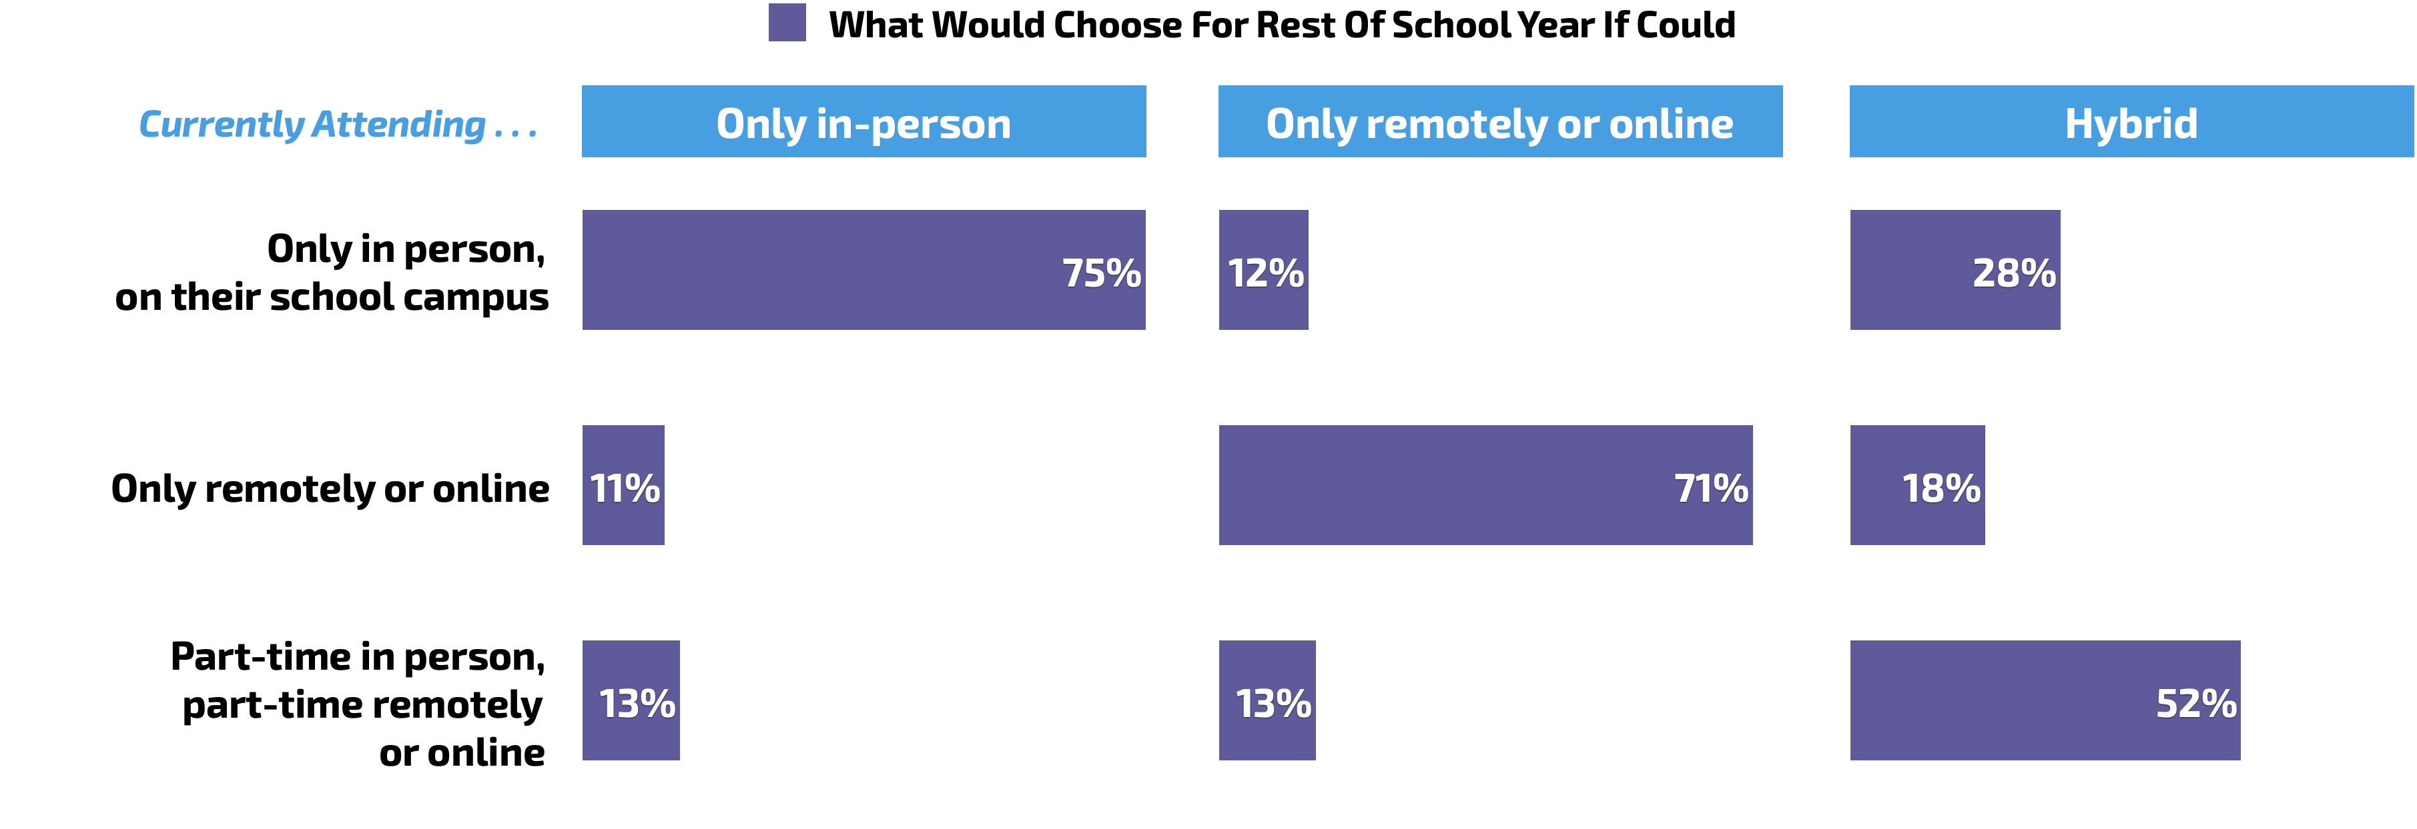
Most Would Choose To Have Child Continue Attending The Way They Are Currently, But Those Doing Hybrid Learning Less Content
Q. How is your child currently attending school?
Q. Now, if your child’s school were to allow you to choose ANY of these ways for your child to attend school for the rest of this school year, which would you choose?
Note: “Something else” and “Unsure” about what they would choose not shown above.

Slide 9
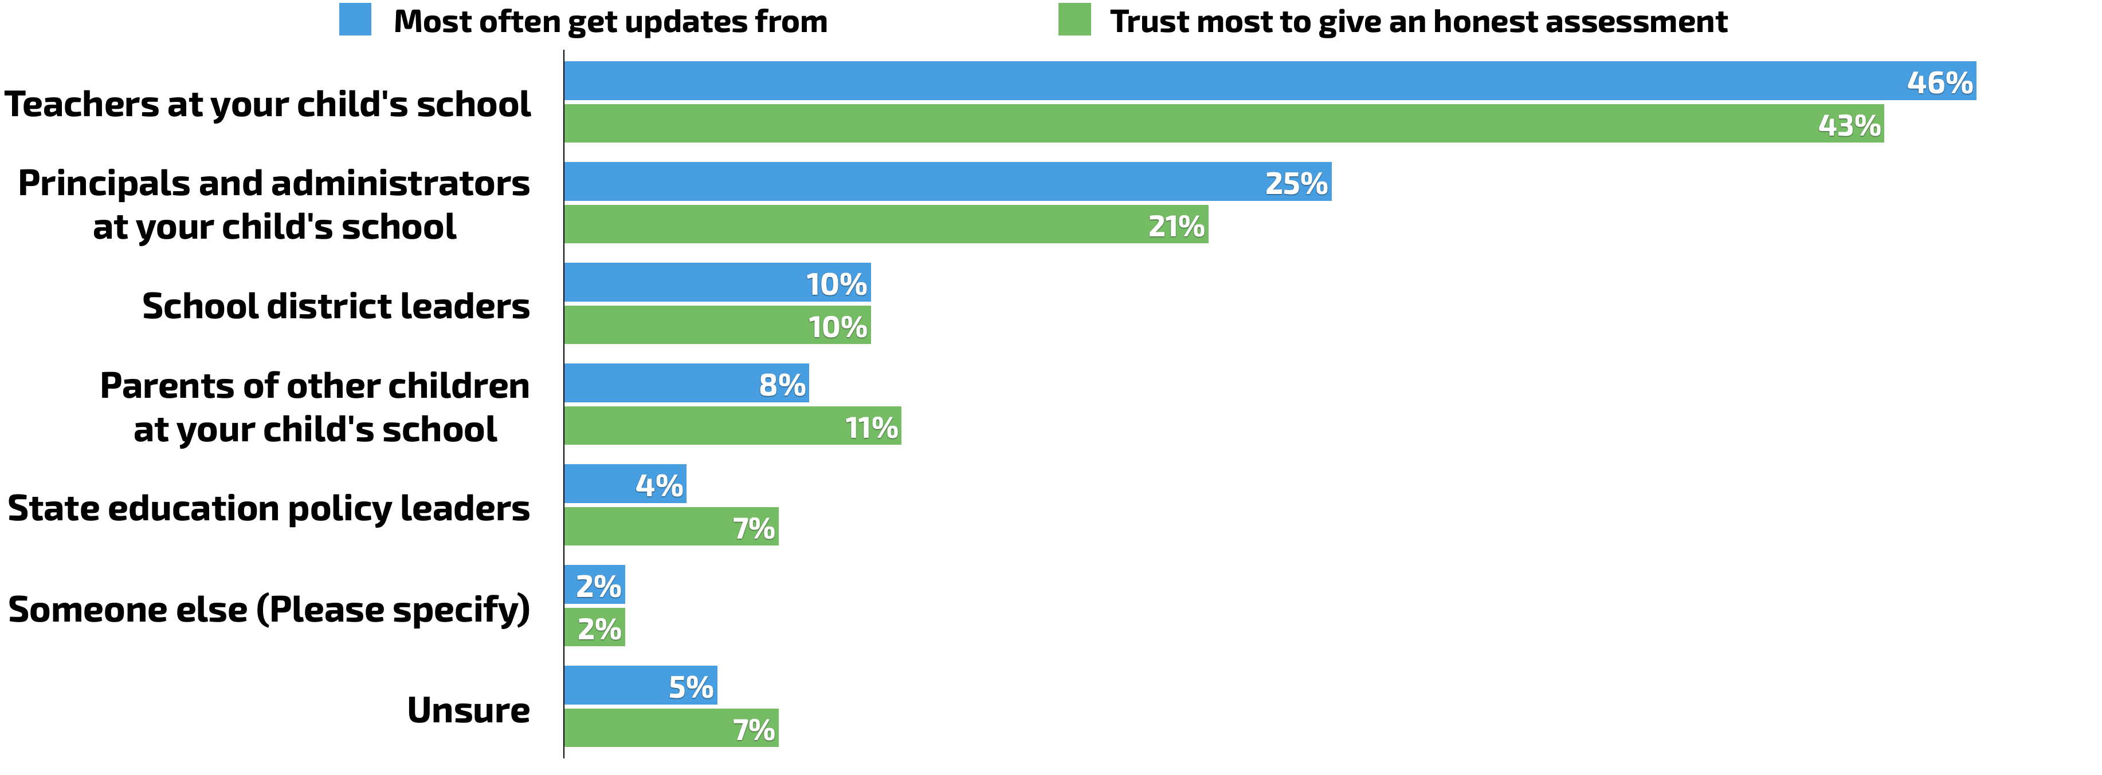
Teachers Most Common And Most Trusted Source Of Info
Q. From whom do you most often hear updates and information about what is going on at your child’s school?
Q. Who do you trust most to give an honest assessment of what is going on at your child’s school?

Slide 10
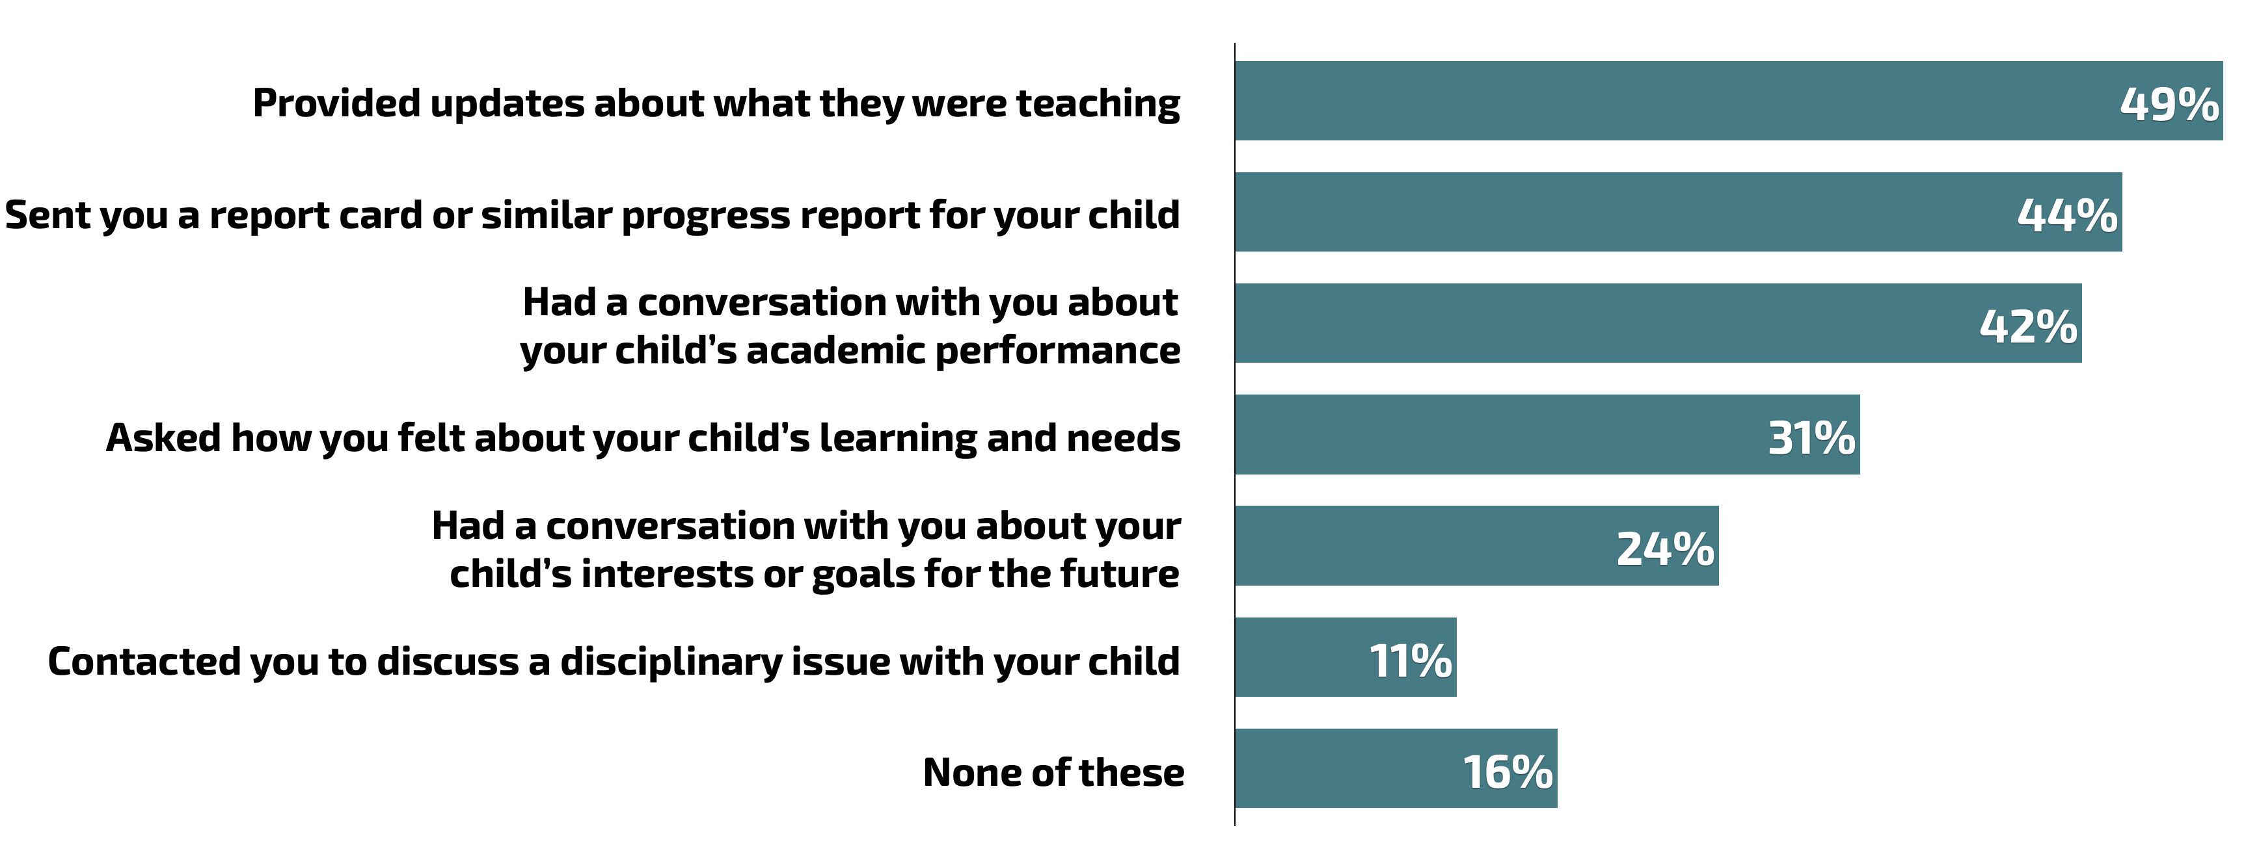
Less Than Half Have Had Conversation About Child’s Academic Performance, And Fewer Have Been Asked How They Felt About Their Child’s Learning
Q. In the past two months, has your child’s teacher communicated with you in any of the following ways? Please select all that apply.
Note: 2% said “Unsure.”

Slide 11
Only Small Differences By Race/Ethnicity
Q. In the past two months, has your child’s teacher communicated with you in any of the following ways? Please select all that apply.
 | All Parents | White | Black | Hispanic | Asian/Other
Provided updates about what they were teaching | 49% | 50% | 54% | 41% | 59%
Sent you a report card or similar progress report for your child | 44% | 46% | 46% | 39% | 43%
Had a conversation with you about your child’s academic performance | 42% | 40% | 45% | 46% | 40%
Asked how you felt about your child’s learning and needs | 31% | 29% | 35% | 33% | 40%
Had a conversation with you about your child’s interests or goals for the future | 24% | 23% | 20% | 27% | 27%
Contacted you to discuss a disciplinary issue with your child | 11% | 9% | 7% | 18% | 14%
None of these | 16% | 18% | 9% | 13% | 16%

Slide 12
Parents Whose Child Is Doing Remote Or Hybrid Learning More Likely To Say School Should Be Doing More To Engage Parents
Q. Do you think your child’s school should be doing more, should be doing less, or is doing about the right amount to engage parents in decisions about their children’s education?

Slide 13
More Than 4 In 10 Hispanic Parents Feel Their Child’s School Should Be Doing More To Engage Parents
Q. Do you think your child’s school should be doing more, should be doing less, or is doing about the right amount to engage parents in decisions about their children’s education?

Slide 14
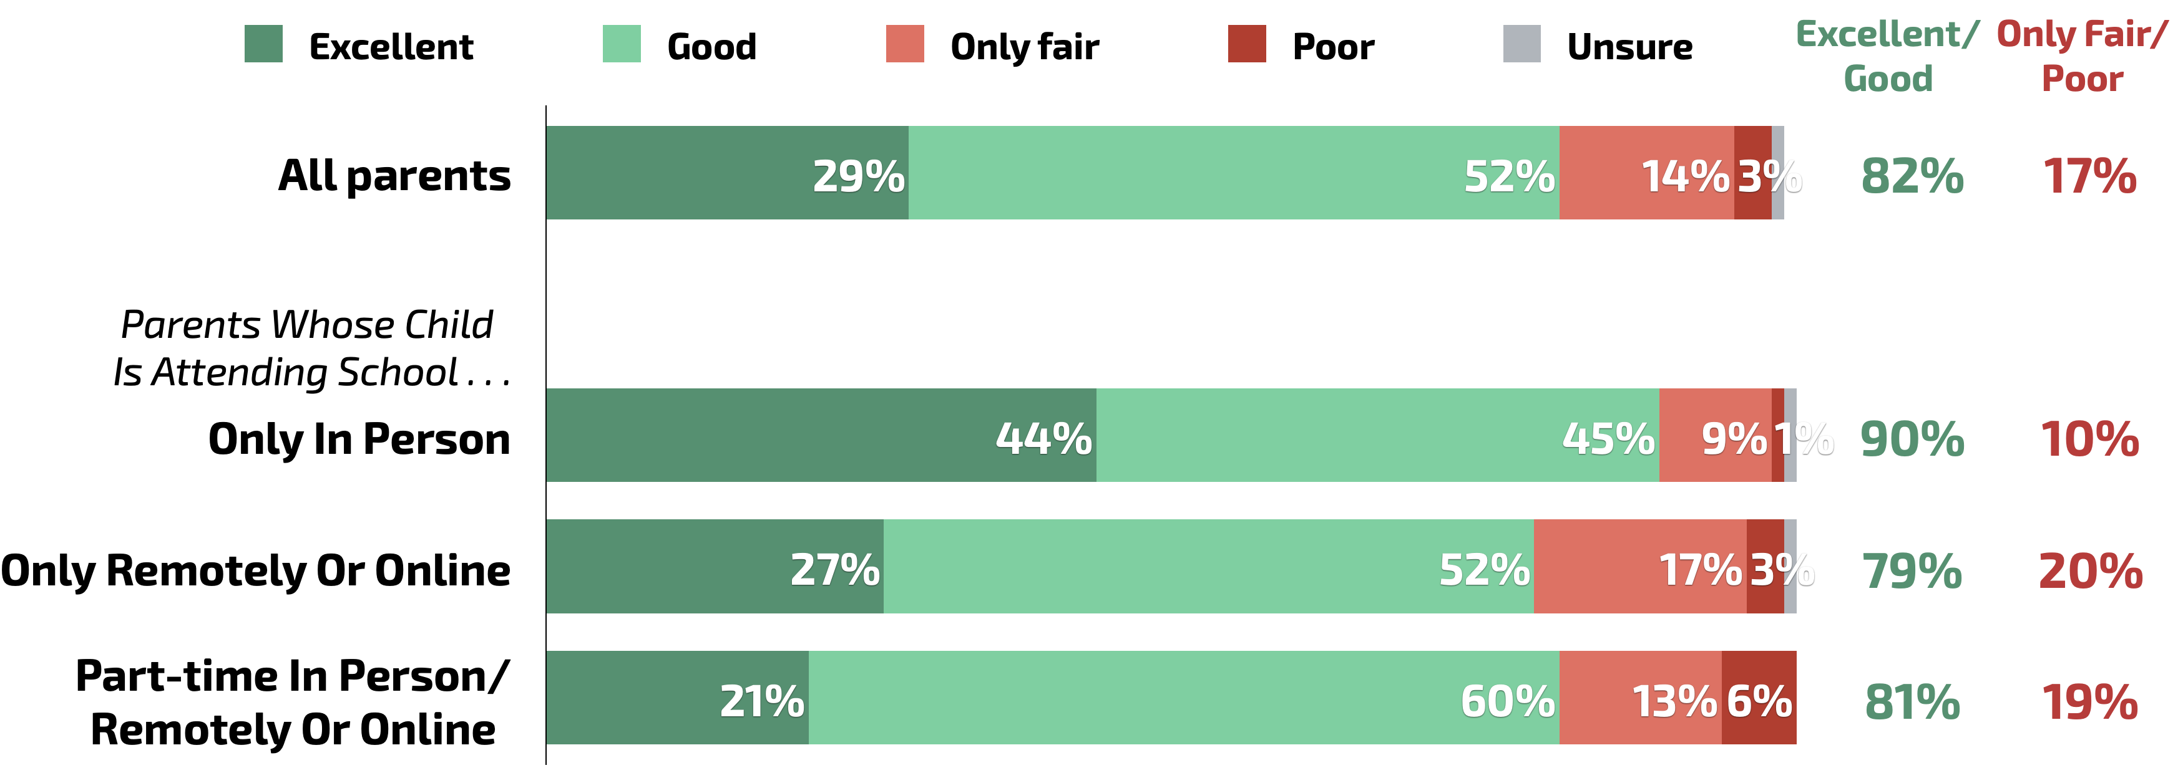
Parents Whose Child Is Doing Remote Or Hybrid Learning
Less Likely To Rate Education Quality Positively
Q. Overall, how would you rate the quality of education your child’s school provides?

Slide 15
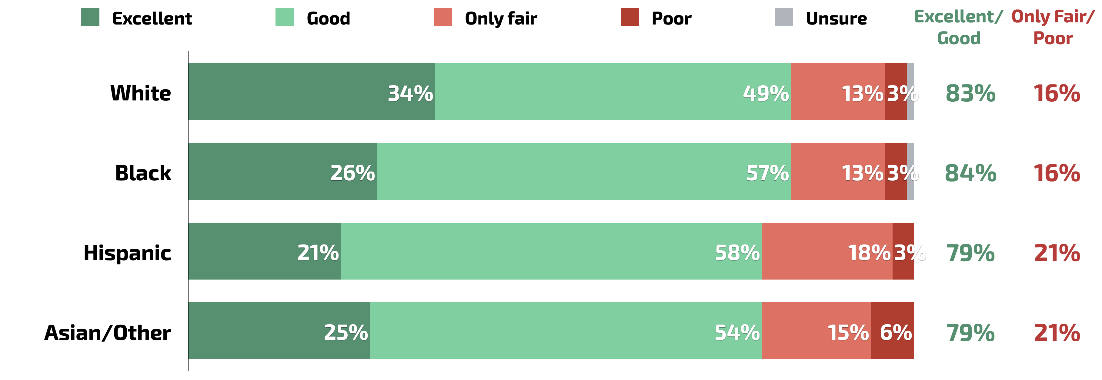
Smaller Differences By Race/Ethnicity In Rating Quality
Q. Overall, how would you rate the quality of education your child’s school provides?

Slide 16
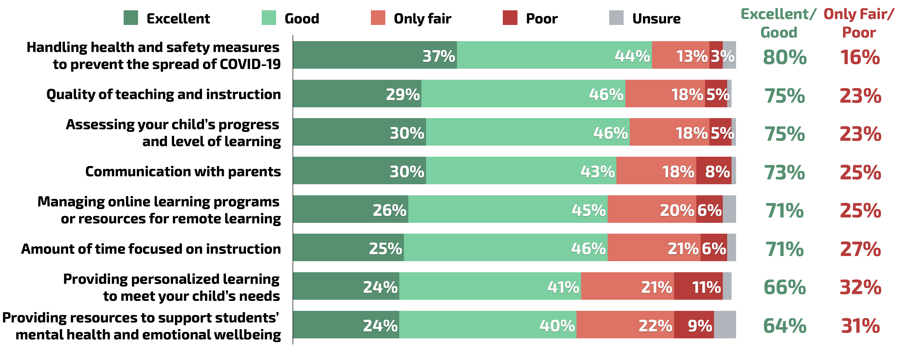
Parents Least Positive About How Schools Are Doing Providing Personalized Learning And Resources For Mental Health And Emotional Wellbeing
Q. How would you currently rate how your child’s school is doing on each of the following?

Slide 17
School Resources For Students’ Mental Health And Emotional Wellbeing Ranked Lowest Last Month As Well
 | Sep. 2020 | Oct. 2020
Handling health and safety measures to prevent the spread of COVID-19 | 72% | 80%
 | 22% | 16%
Quality of teaching and instruction | 70% | 75%
 | 28% | 23%
Assessing your child’s progress and level of learning | 66% | 75%
 | 30% | 23%
Communication with parents | 68% | 73%
 | 30% | 25%
Managing online learning programs or resources for remote learning | 65% | 71%
 | 30% | 25%
Amount of time focused on instruction | - | 71%
 | - | 27%
Providing personalized learning to meet your child’s needs | - | 66%
 | - | 32%
Providing resources to support students’ mental health and emotional wellbeing | 57% | 64%
 | 37% | 31%
Rate as . . .
Excellent/Good
Only Fair/Poor

Slide 18
Parents Of Child Doing Remote Or Hybrid Learning Give Less Positive Ratings Of All Aspects Of School Performance
Q. How would you currently rate how your child’s school is doing on each of the following?
% Only Fair/Poor | Only In-Person | Only Remotely Or Online | Hybrid
Handling health and safety measures to prevent the spread of COVID-19 | 9% | 18% | 19%
Quality of teaching and instruction | 12% | 26% | 26%
Assessing your child’s progress and level of learning | 13% | 25% | 27%
Communication with parents | 17% | 28% | 28%
Managing online learning programs or resources for remote learning | 21% | 26% | 28%
Amount of time focused on instruction | 15% | 29% | 34%
Providing personalized learning to meet your child’s needs | 22% | 34% | 36%
Providing resources to support students’ mental health and emotional wellbeing | 19% | 35% | 32%

Slide 19
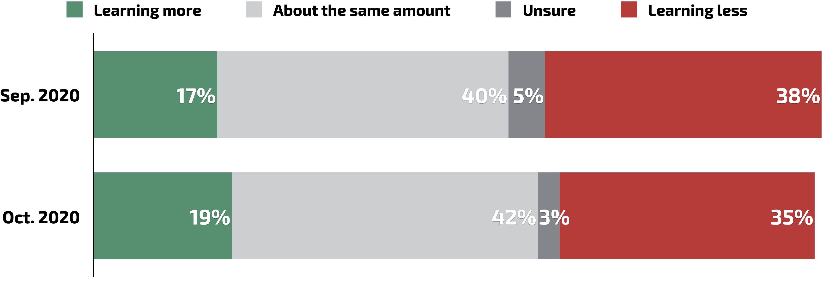
Consistent With Last Month, Plurality Feel Their Child Learning Same Amount, But More Than A Third Feel They Are Learning Less
Q. At this point in the school year, do think your child is learning more than they normally would, less than they normally would, or about the same amount as they normally would when attending school?

Slide 20
Parents Whose Child Is Doing Remote Or Hybrid Learning More Likely To Feel Their Child Is Learning Less
Q. At this point in the school year, do think your child is learning more than they normally would, less than they normally would, or about the same amount as they normally would when attending school?

Slide 21
Similar Shares Of White, Black, And Hispanic Parents Feel Child Is Learning Less Than They Normally Would
Q. At this point in the school year, do think your child is learning more than they normally would, less than they normally would, or about the same amount as they normally would when attending school?

Slide 22
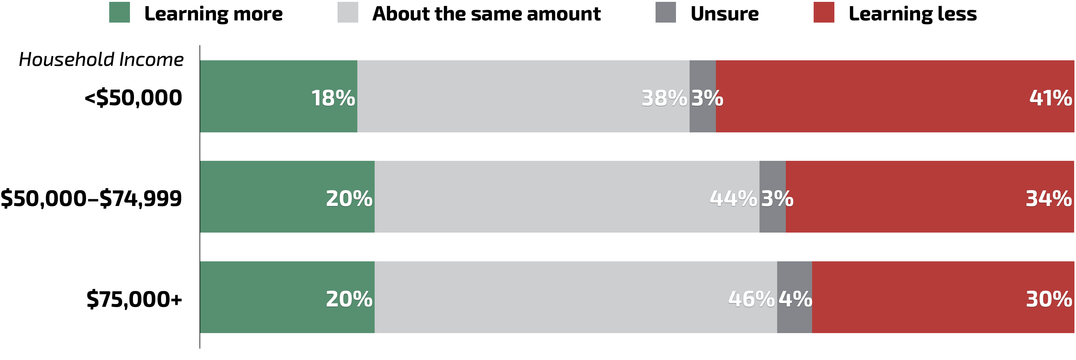
4 In 10 Parents With Incomes Under $50K Say Their Child Is Learning Less Than They Normally Would
Q. At this point in the school year, do think your child is learning more than they normally would, less than they normally would, or about the same amount as they normally would when attending school?

Slide 23
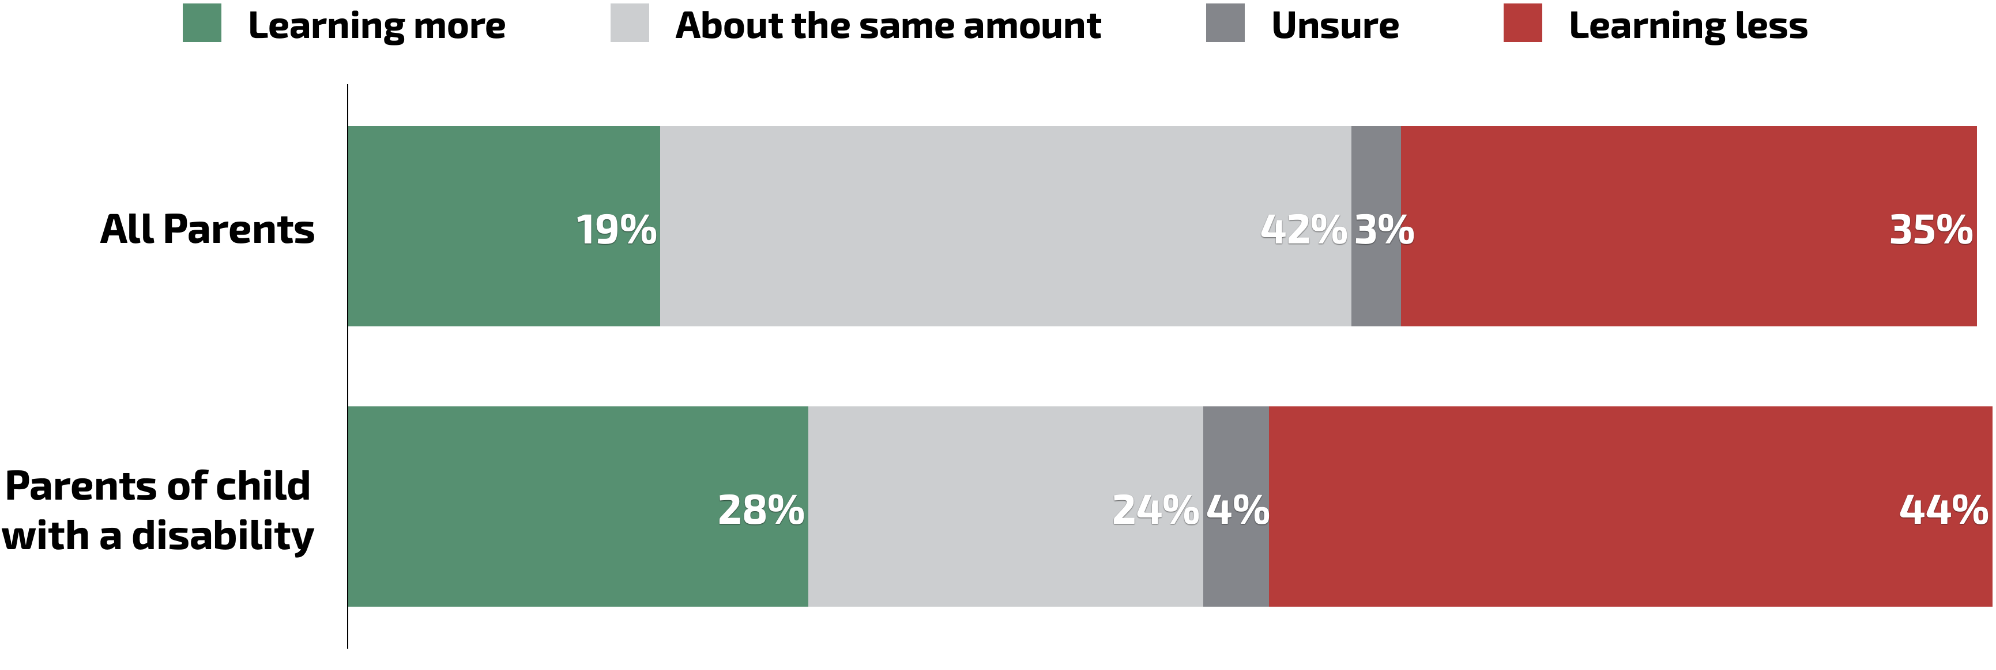
Parents Whose Child Has A Disability More Likely To Report Child Is Learning Different Amount, And Plurality Say They Are Learning Less
Q. At this point in the school year, do think your child is learning more than they normally would, less than they normally would, or about the same amount as they normally would when attending school?

Slide 24
Views On Current Situation
And Rethinking Education

Slide 25
Black And Hispanic Parents Somewhat More Likely To Support Statewide Testing This Year
Q. There has been some debate about whether or not schools should administer statewide academic tests this school year. Even if neither one perfectly describes your views, which of the following statements do you agree with more?
Even though we are in challenging times, we should continue to assess how well students are learning using statewide tests so that we can compare results to previous years and schools can identify areas students may be falling behind or need support.
Since we are in challenging times, we should take a break from statewide testing this year so that teachers and students have one less thing to worry about.
Unsure

Slide 26
Majority Continue To Say Providing Access To High-Quality Remote Learning Should Be Priority
Q. If you could send a message to people who make decisions about education policy and public schools, which of the following do you think they should prioritize this school year?
Providing access to consistent, high-quality remote or online learning for public school students this school year
Trying to get public school students back into the classroom this school year and implementing health and safety measures
Unsure

Slide 27
Most Parents Say Schools Should Continue Providing Remote Learning Options In Future Years After The Pandemic Is Over
Q. Thinking about future school years after the pandemic is over and a vaccine for COVID-19 is widely available, do you think . . .?
Schools should continue providing the online or remote learning options for students that they are offering now
Schools should go back to having all students attend school in-person
Unsure
Have any children
attending . . .

Slide 28
More Than 6 In 10 Say Schools Should Focus On Rethinking Education And Coming Up With New Ways To Teach
Q. Even if neither one perfectly describes your views, which of the following statements do you agree with more?
Schools should be focused on trying to get back to the way things were before the COVID-19 crisis as soon as it is safe to do so.
School should be focused on rethinking how we educate students, coming up with new ways to teach children moving forward as a result of the COVID-19 crisis.
Unsure

Slide 29
Around Two-Thirds Rate K-12 Public Schools In US Positively
Q. In general, how would you rate the quality of education that K-12 public schools in the United States provide?
Excellent/
Good
Only Fair/
Poor
67% | 31%
67% | 31%
62% | 36%
73% | 27%
57% | 37%

Slide 30
Parents Rate Quality Of Education In K-12 Public Schools In General Less Positively Than Their Own Child’s School
Q. Overall, how would you rate the quality of education your child’s school provides?
Q. In general, how would you rate the quality of education that K-12 public schools in the United States provide?
Excellent/
Good
Only Fair/
Poor
82% | 17%
67% | 31%

Slide 31
Three Quarters Would Support Establishing A Right To Quality Public Education As A Civil Right
Q. Would you support or oppose changing laws to establish a right to quality public education as a civil right in the same way that the right to vote is, meaning the government would be obligated by law to provide every child access to a quality education, and that the government could be challenged in court if that right is infringed upon?
Support
(Total)
Oppose
(Total)
75% | 9%
76% | 11%

Slide 32
Most Parents Supportive Of School Choice
Q. Even if neither one perfectly describes your views, which of the following statements do you agree with more?
Those who support school choice say that all parents should be able to send their child to a good quality school regardless of their zip code or financial situation, and that means public education funding should follow the student to whatever school their parents decide is best for them.
Those who oppose school choice say that public education funding should continue to be given to public schools the way it currently is, and that school choice just encourages districts to abandon struggling schools rather than working to fix them.
Unsure

Slide 33
Parents Rate Reading, Writing, and Communication Skills As Most Important, Followed By Critical Thinking Skills, Life Skills, And Career Skills
Q. Thinking about what a good K-12 public education looks like, which one or two of the following do you think are MOST important for students to learn by the time they finish high school?

Slide 34
Views On Disciplinary Policies
And Racial Inequality

Slide 35
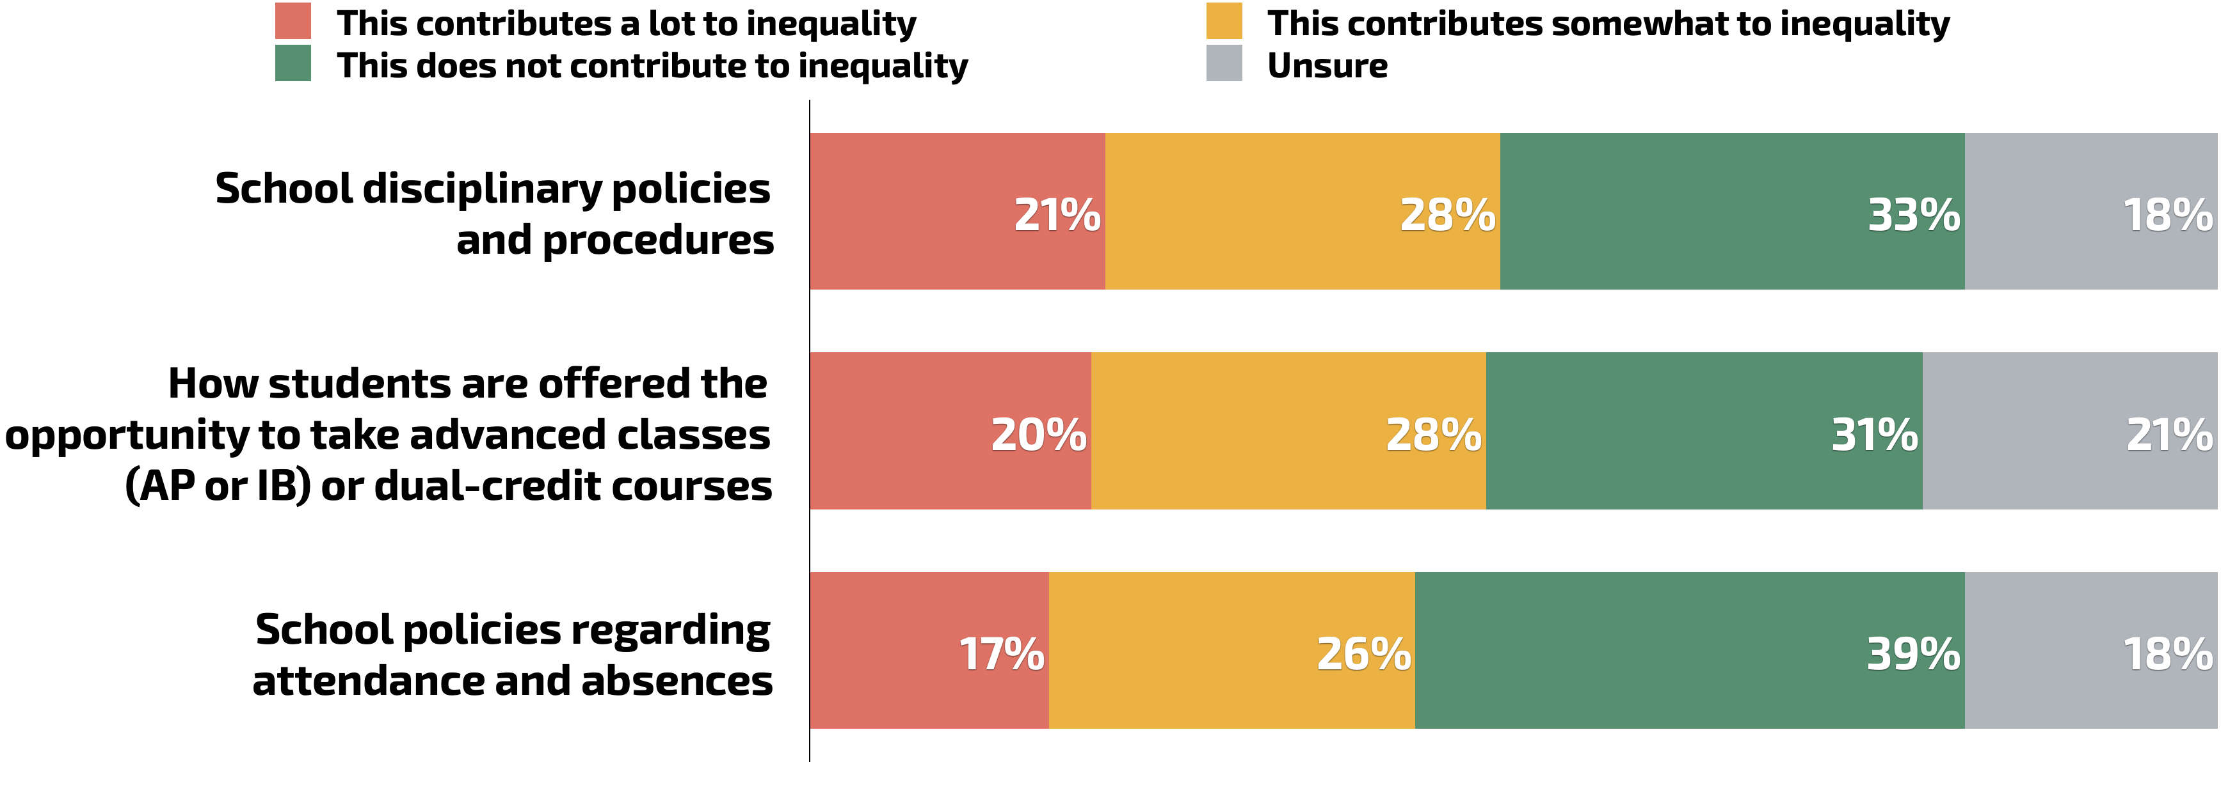
Nearly Half Think School Disciplinary Policies And How Students Are Offered Opportunity For Advanced Classes Contribute To Greater Inequality
Q. To what extent, if at all, do you think the way schools handle each of the following creates greater inequality for students of color?

Slide 36
Black Parents Most Likely To Say Disciplinary Policies Contribute To Greater Inequality For Students Of Color
Q. To what extent, if at all, do you think the way schools handle each of the following creates greater inequality for students of color?
School disciplinary policies and procedures

Slide 37
6 In 10 Black And Hispanic Parents Say How Students Are Offered Opportunity To Take Advanced Classes Contributes To Inequality
Q. To what extent, if at all, do you think the way schools handle each of the following creates greater inequality for students of color?
How students are offered the opportunity to take advanced classes (AP or IB) or dual-credit courses

Slide 38
Smaller Differences On Attendance Policies, But Black And Hispanic Parents Still More Likely To Say Such Policies Contribute To Inequality
Q. To what extent, if at all, do you think the way schools handle each of the following creates greater inequality for students of color?
School policies regarding attendance and absences

Slide 39
Most Parents Say Schools Should Rely Less On School Police Officers In Disciplinary Situations, Including 3 In 4 Black Parents
Q. Even if neither one perfectly describes your views, which of the following statements do you agree with more?
In disciplinary situations, schools should rely less on school police officers and move toward providing social emotional supports to address student needs with staff like counselors, psychologists, and social workers
In disciplinary situations, schools should continue to rely on school police officers in the way they do now
Unsure

